Slide 1

Today’s Session
Agenda:
Quick Understanding of AI in Fusion HCM
Quick Win Opportunity: Benefits Plan Advisor
Best Practices & Considerations to deploy AI in Fusion HCM
Notes:
Updated 9/18

Slide 2
Oracle AI is designed to be simple and safe for business
Data privacy and security
Human oversight
AI embedded within core workflows
Flexible and built for change
With OCI Generative AI Service, your data is not seen by other customers.
Custom models trained on your data can only be used by you.
You remain in control of AI and can augment or override its output at any time, and supervise actions as you see fit.
Embedded AI is designed to improve productivity and the customer and employee experience.
AI features are ready to use out-of-the box at no additional cost and can be configured to meet your unique business needs.

Slide 3
Oracle AI in HCM
HUMAN RESOURCES
Agentic Application
Manager Concierge Workspace My Help Workspace for Employees Contract Compliance Workspace
Generative AI
About Me Case Summarization and Resolution Compensation Plan Instructions Communication Content Generation End of Call Summary Notes Employment Process Notes Employment process approval comments Document Type Descriptions Help Desk Request Resolution Help Desk Request Summary Knowledge Article Suggestion Knowledge Article Summary Knowledge Search Answers Knowledgebase Articles Manager Survey Analytics Market Composite Summary Resolution Notes Survey Questions Workflow Journeys and Tasks
HUMAN RESOURCES
AI Agent
Benefits Certification Assistant Benefits Plan Advisor Benefits Policy Advisor Case Analyzer Compensation Advisor Compensation Guidelines Analyst Compensation Statement Analyst Document Records Management Assistant Employee Concierge Employee Help Desk Assistant Employment Lifecycle Policy Analyst Employment Information Advisor Job Creation Assistant Journeys Support Analyst Manager Concierge Manager Salary Change Assistant Marital Status Update Assistant Onboarding Assistant Org Chart Analyst Perks and Awards Analyst Personal Contribution Assistant Personal Information Advisor Positions Assistant Promotion Advisor Representative Responsibility Analyst Resignation Advisor Retirement and Pensions Analyst Tax Withholding Guide Transaction Administration Assistant Workforce Structures Insight Analyst
RECRUITING
Agentic Application
Hiring Workspace for Store Managers
Classic AI
Similar Candidates Similar Jobs Suggested Candidates Recommended Jobs Time to Hire
Generative AI
Candidate Email and Text Messages Candidate Experience Summary Candidate Search Query Candidate Q&A Candidate Score Career Site Content Interview scheduling information Job Applicant Score Job Application Overview Job Category Tiles and Landing pages Job Posting Descriptions
AI Agent
Career Coach Employee Hiring Advisor Interview Management Assistant Job Applicant Screening Advisor Job Offer Analyst Job Requisition Analyst Recruiting Email Response Assistant
CAREER DEVELOPMENT
Agentic Application
Team Learning Workspace for Managers Career Advancement Command Center
Classic AI
Career Path Recommendations Growth Opportunities Skills Management Skills Recommendations
Generative AI
Job and Position Descriptions Learning Descriptions Role and Capability Guide Descriptions Skill Descriptions Skill Rating Assessments
AI Agent
Career Planning Guide Job Discovery Advisor Job Fit Advisor Job Seeker Analyst Learning and Training Advisor Learning Tutor
PERFORMANCE MANAGEMENT
Agentic Application
Team Talent Calibration and Review Workspace
Classic AI
Suggested Successor
Generative AI
Check-In Conversation Summary Check-in Discussion Topics Development Tips Succession Planning Summary Employee feedback summary Feedback Comments Goal Creation Team Goal Creation Team Goal Summaries Performance Review Summary Recognition Comments
AI Agent
Performance and Goals Assistant Succession Planning Advisor Talent Advisor Talent Review Assistant Team Goals Assistant Team Sync Advisor
WORKFORCE MANAGEMENT & Payroll
Agentic Application
Workforce Operations Command Center
AI Agent
Collective Agreements Analyst Employee Contracts Analyst Leave and Absence Analyst Leave and Absences Policy Advisor Court Order Assistant Pay Policy Advisor Payroll Run Analyst Payslip Analyst Shift Scheduling Assistant Time Entry Assistant Timecard Assistant Working Hours Change Assistant
3

Slide 4
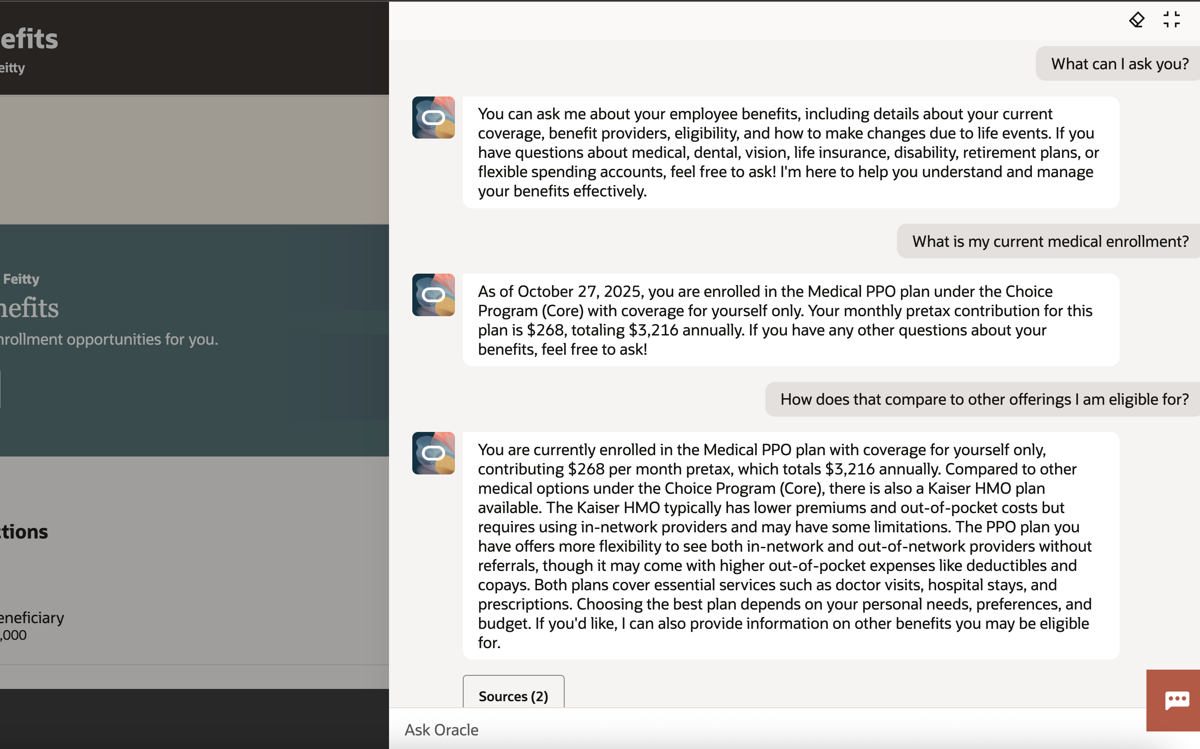
        Benefits Plan Advisor
Instantly view current medical enrollments (medical, dental, vision, retirement, and other)
Access detailed plan and provider information including coverage, policy features, costs
Estimate tax savings and contribution impacts with HSA and FSA Calculators
Step-by-step supporting during life events and enrollment windows.
Email benefits representative for additional help

Slide 5
Fusion AI Agent Adoption Story: Northwell
Customer Details:
Geography | North America
Industry | Healthcare
Company Size | $19 billion revenue / 104,000 employees
Agent(s) Implemented:
HCM | Benefits | Open Enrollment Advisor
Business Value +
Impact:
Northwell has seen an increase in the volume of employee inquiries into their HR shared service center. With only 21 FTES supporting phone, live chat, and service requests, the team was hitting capacity constraints. Their volume surges during period like Open Enrollment and further constrains the team and the timeliness/quality of responses to employees. Implementation of the Benefits Open Enrollment Agent allowed Northwell to flex to the increased traffic of inquiries without adding headcount. During the 2025 Open Enrollment period, the agent responded to 12,095 inquiries with an 85% defection rate. The introduction of the agent delivered an exceptional, personalized support experience to employees at scale. The agent was built to ensure the employee responses were tailored to the employee’s benefit group, pay cycle, union status, geographic area, and more. Use of an agent in the process enabled employees to receive real-time responses so that they could complete their enrollment process in one interaction. By removing the need to interact with a service desk team member, employees are able to complete their enrollment more quickly and get back to providing service to patients in their health system. Introduction of the agent also positions Northwell to scale for future growth (e.g. mergers and headcount increases) without strain on HR resources.

